Slide 1
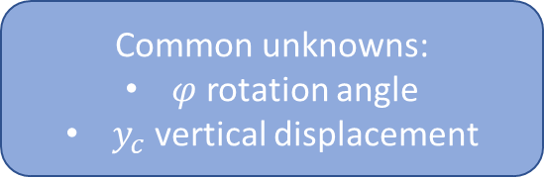
Forces imposed rolling condition
Force and Moment imposed rolling condition
Common unknowns:
$φ$ rotation angle
$y_{c}$ vertical displacement
Rim
Rim
Rim
Rim
Fx
Mz
At time t, the distance covered by the wheel is speed * time
Fy
Fy
Ground
Ground
Ground
Ground
y
Unilateral contact with friction in both cases
Inputs
z
x

Slide 2


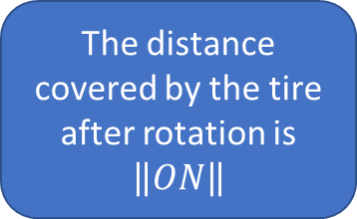
Wheel after a $φ$ angle rotation
Rotation by an angle $φ$
Rim
Rim
Rim
Rim
M
M
N
N
O
Ground
Ground
Ground
Ground
y
Points M and N coincide but M is on the tire and N on the ground
The distance covered by the tire after rotation is $\left\|ON\right\|$
z
x

